Slide 1
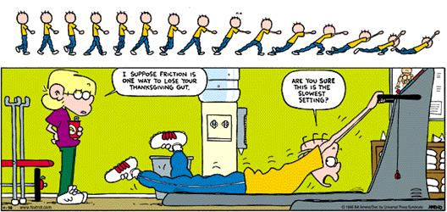
Friction and Newton’s Laws

Slide 2

Example: Friction and Kinematics
A box of mass 5.7 kg slides across a floor and comes to a complete stop. Its initial velocity was 2.8 m/s [f] and the coefficient of friction between the box and the floor was 0.34.
a) Draw a FBD of the box while it is in motion. Calculate the value of all forces.

Slide 3
Example: Friction and Kinematics
b) Write two net force statements for the box.
c) Calculate the acceleration of the box..
d) Calculate the displacement of the box for the duration of its motion.

Slide 4
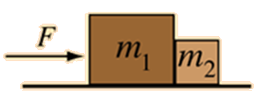
Example: Friction and Multiple Body Problems
A 5.0 kg and a 10.0 kg box are touching each other. A 45.0 N horizontal force is applied to the 5.0 kg box in order to accelerate both boxes across the floor. The coefficient of kinetic friction between each box and the floor is 0.23.
Draw a FBD for each box. Identify any action reaction pairs.

Slide 5
Example: Friction and Multiple Body Problems
b) Write two net force statements for each box.
c) Determine the magnitude of the acceleration of the boxes.
d) Determine the magnitude of the force acting between the two boxes.

Slide 6
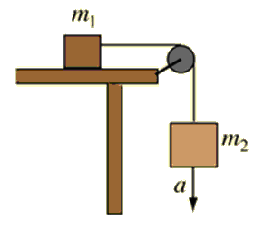
Example: Friction and Pulley Problems
A 4.0 kg box is resting on a horizontal table. It is attached by a massless string over a frictionless pulley to a hanging box with a mass of 5.0 kg. The coefficient of kinetic friction is 0.45.
Draw a FBD for each box. Identify any action reaction pairs.

Slide 7
Example: Friction and Pulley Problems
b) Write two net force statements for each box.
c) Determine the magnitude of the acceleration of the boxes.
d) Determine the magnitude of the tension force.

